Slide 1

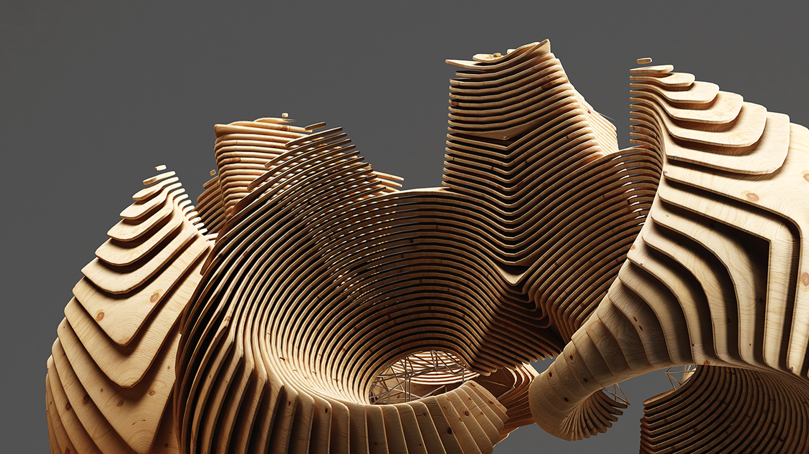
CQ Gems
Inside ACS AEM Commons & Tools
© 2014 Adobe Systems Incorporated. All Rights Reserved. Adobe Confidential.

Slide 2
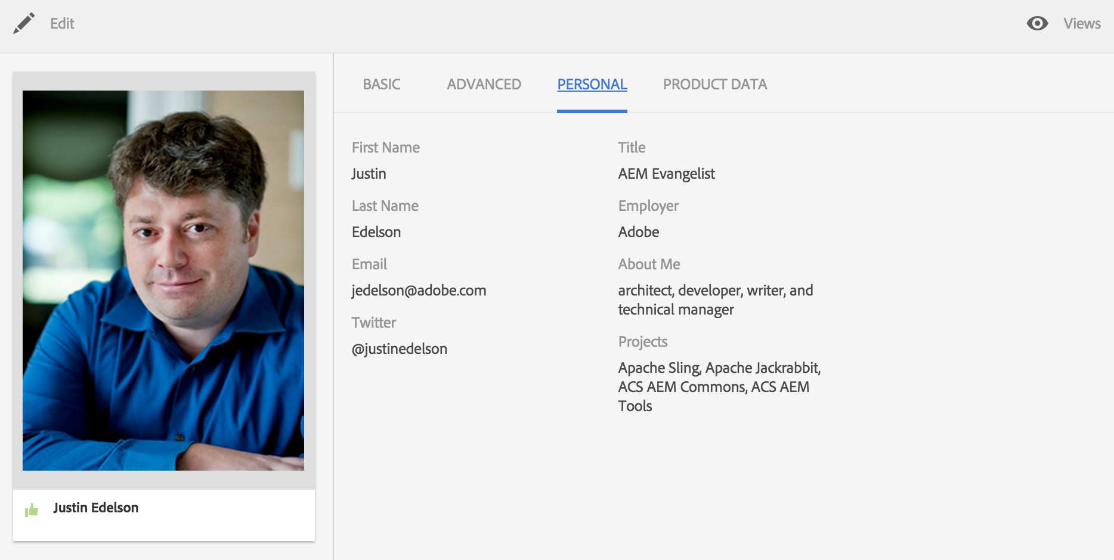
About Me

Slide 3
Agenda
Background
Project Structure
Demos
Contributions and Support
Q&A

Slide 4
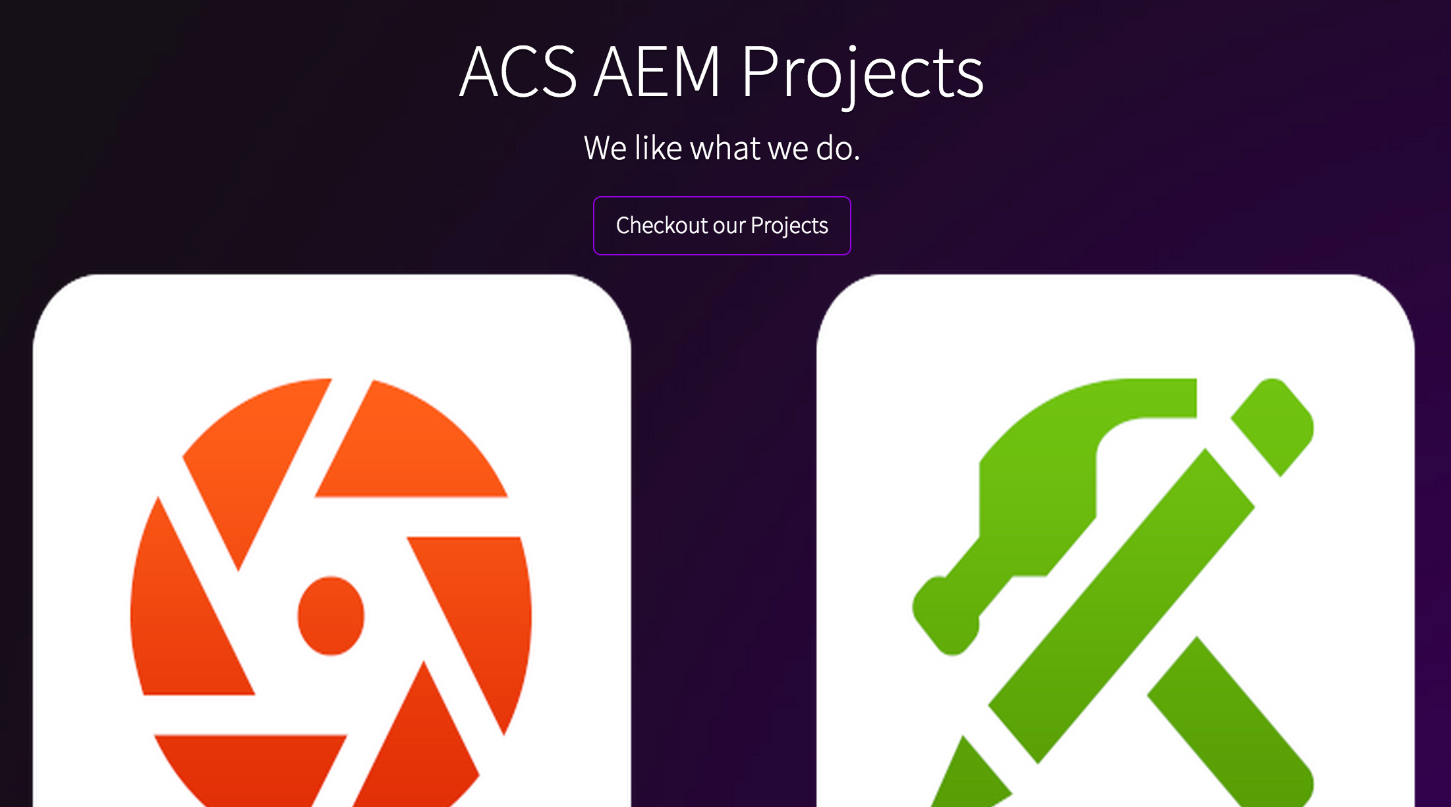

Slide 5
Projects
ACS AEM Commons
An AEM development and component toolkit for bootstrapping any AEM project
ACS AEM Tools
A set of tools for AEM to make developer lives easier
ACS AEM Samples
Collection of AEM code samples, examples and templates

Slide 6
Timeline
April 2013 – Internal Adobe Consulting project started.
October 2013 - Moved to GitHub & Released ACS AEM Commons 1.0.0
December 2013 – Released ACS AEM Tools 0.0.2
May 2014 – Removed CQ 5.6 Support (version 1.6.0)
January 2015 – Created ACS AEM Samples
May 2015 – Oak Index Manager & Explain Query Released in AEM 6.1
August 2015 – Removed AEM 5.6.1 Support (version 2.0.0)

Slide 7
Goals
Collect Common Utility Code
Provide Illustrative Code of Design Patterns and Features
Experiment

Slide 8
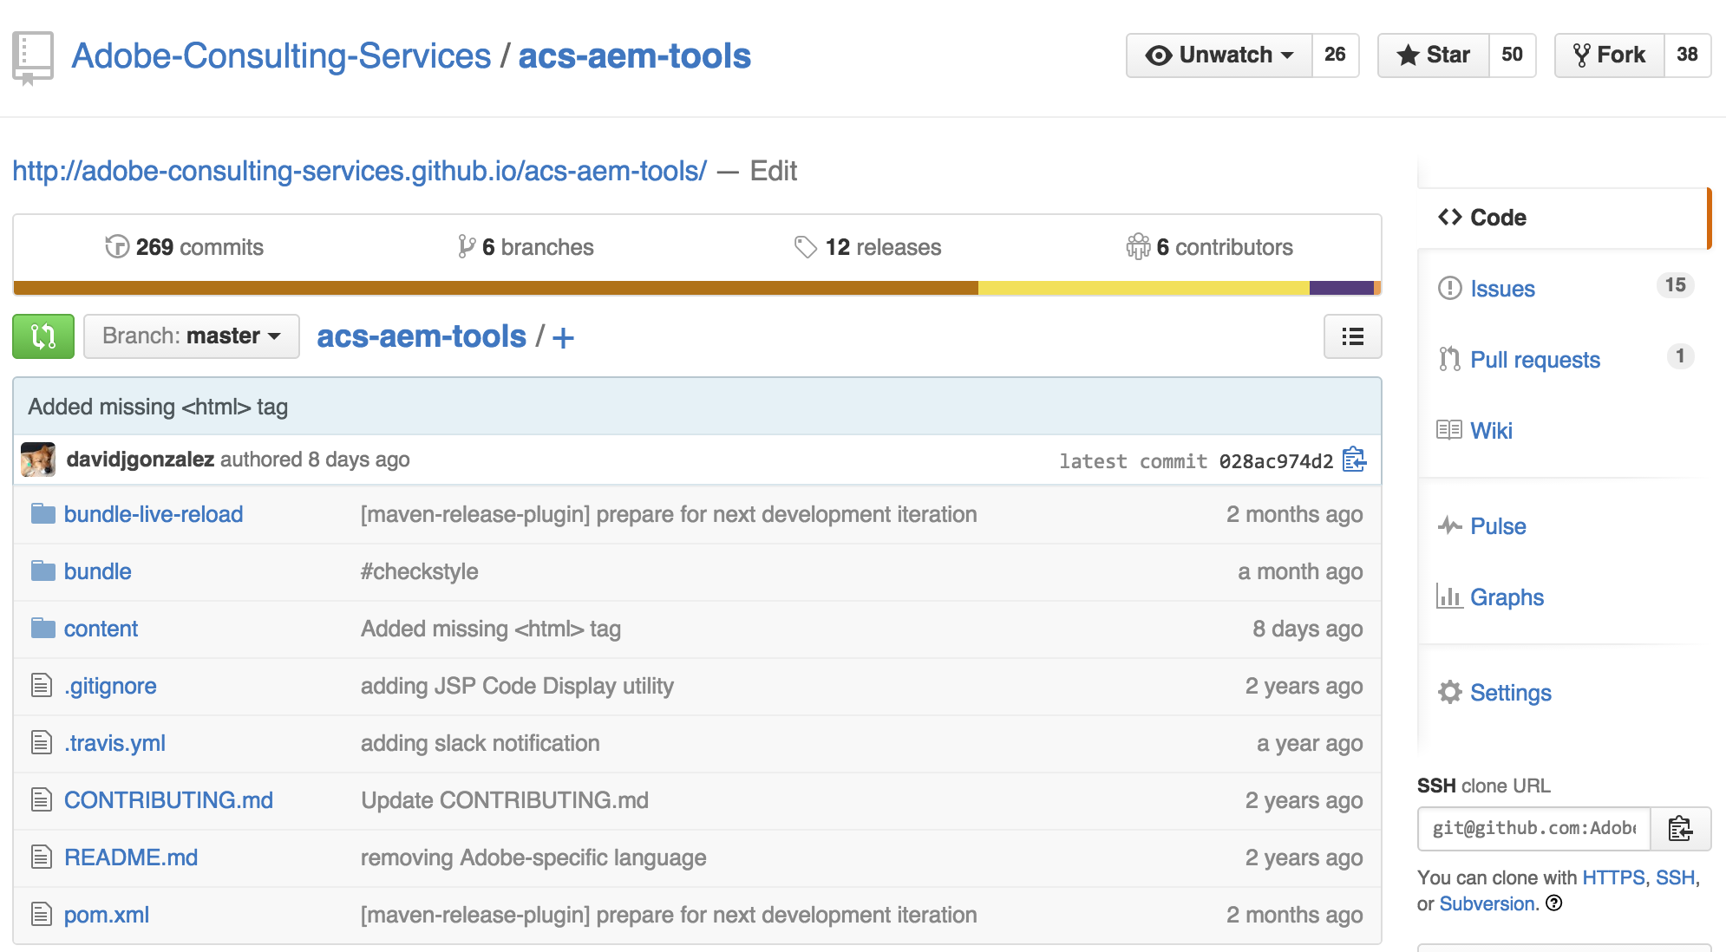
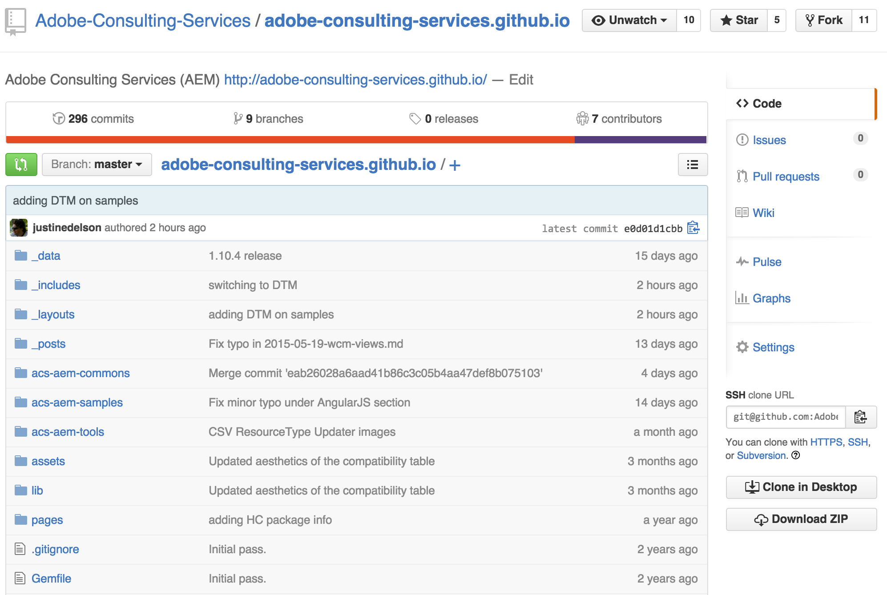
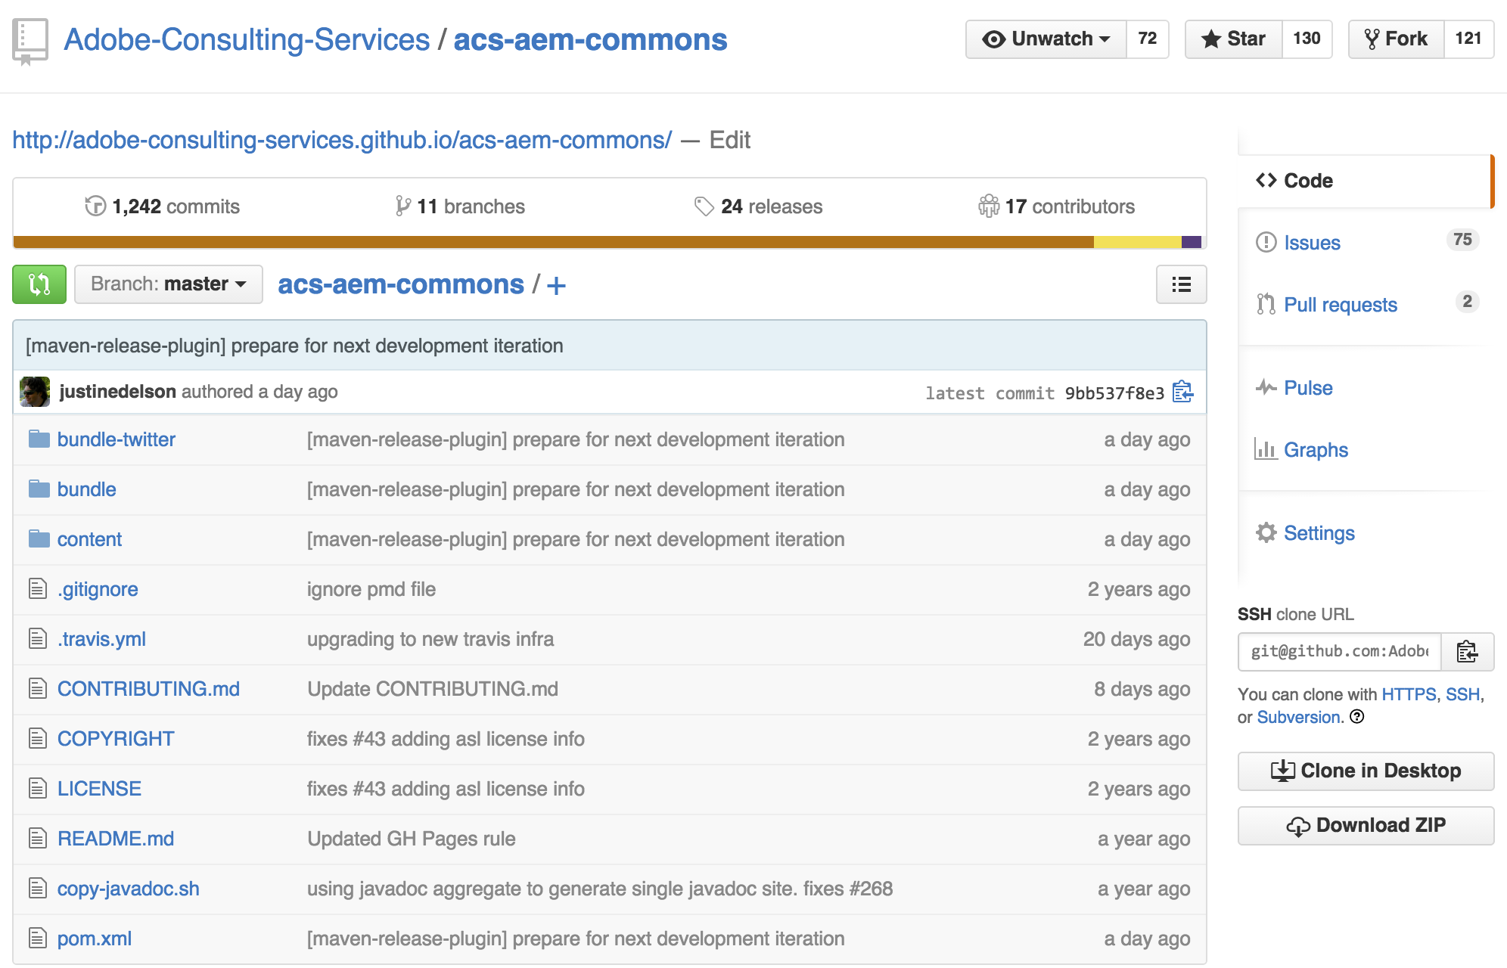
Project Structure
Twitter OSGi Bundle
Main OSGi Bundle
Live Reload OSGi Bundle
Content Package
Main OSGi Bundle
Content Package

Slide 9
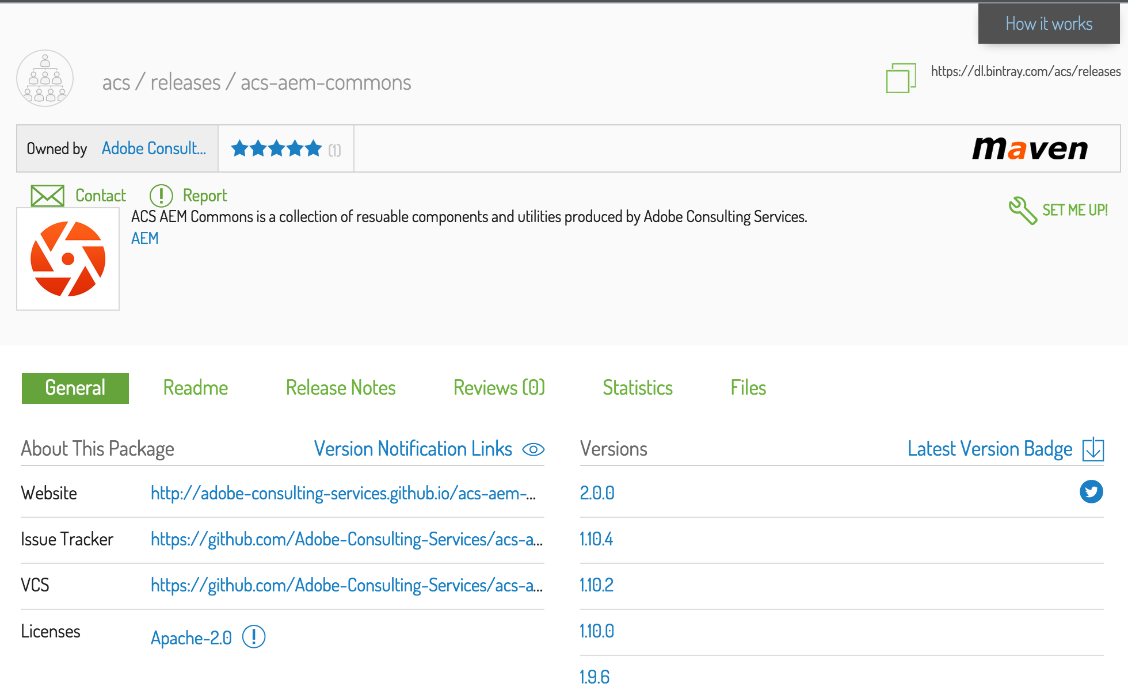
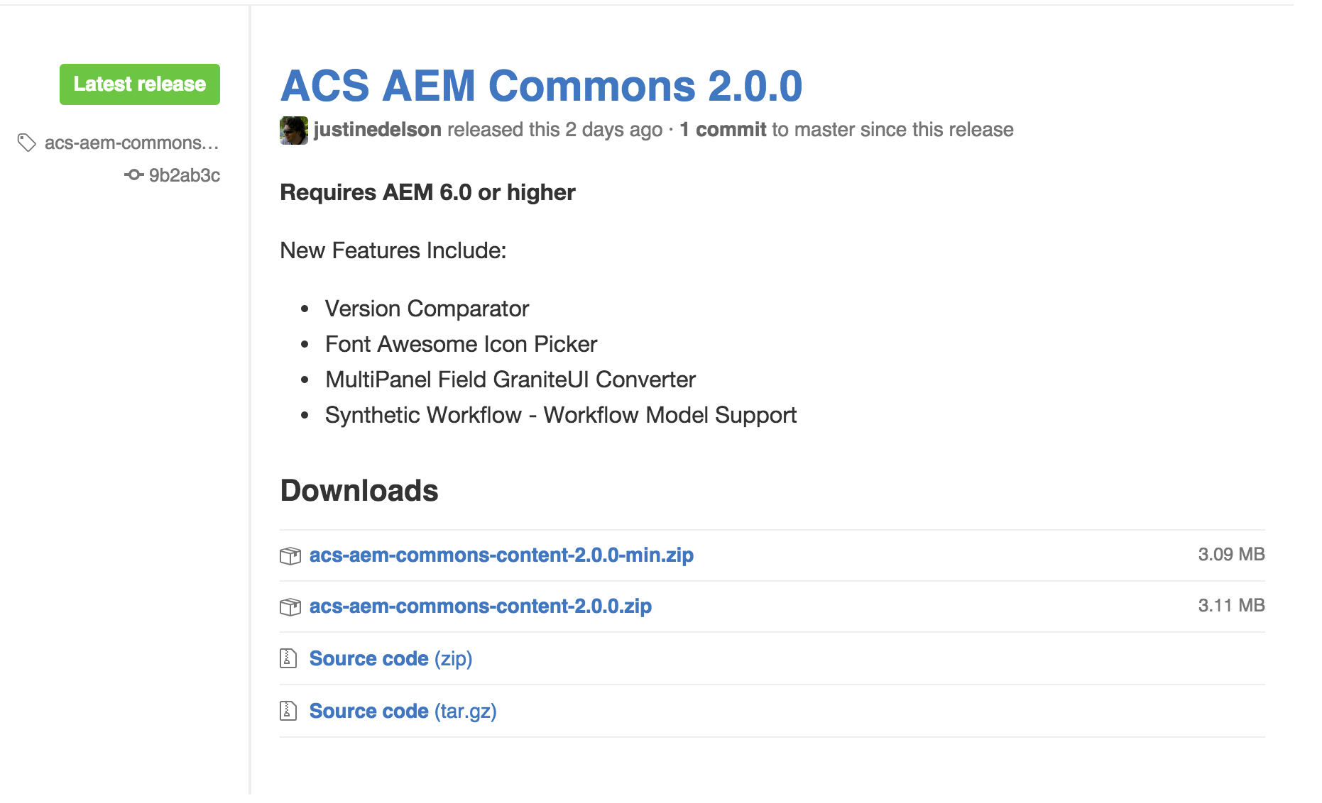
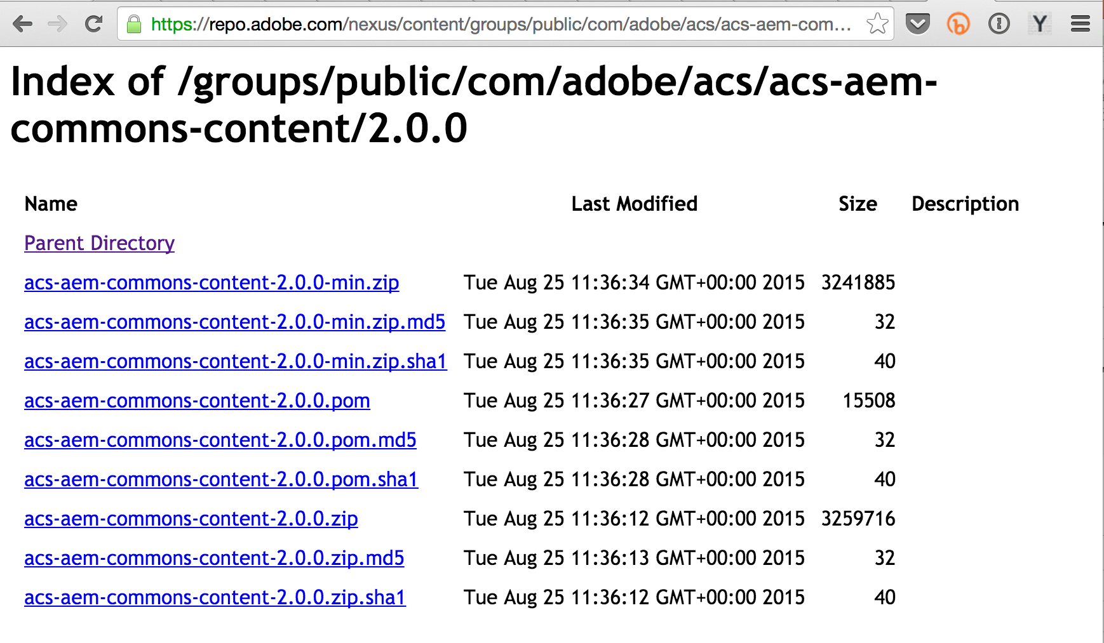
Releases

Slide 10
Demo

Slide 11
Contributing
Contributions are welcome from anyone
NOT just Adobe
Contribution Types
New Features / Improvements (Pull Request)
Bug Fix (Pull Request)
Documentation (Pull Request)
Bug Reports (Issues)
Feature Ideas (Issues)
Contribution guide - http://bit.ly/commons-contribute

Slide 12
Support
ACS AEM Commons & Tools are not supported through DayCare
Please file issues directly using GitHub Issues.

Slide 13


